Slide 1
Chapter #3 Process Scheduling
11 January, 2022
JONG KI PARK
jkipark1@naver.com

Slide 2
Chapter Objectives
Process Scheduling
Process Scheduling
- What is process scheduling
Multitasking
- preemptive or cooperative(nonpreemptive)
Nice value
See through CFS
Time accounting
Process selection
The scheduler entry point & Sleeping and waking up
Summary

Slide 3
Introduction
Process Scheduling
- One process at a time in single processor
- Deciding which process runs, when, and for how long -> Multitasking
Multitasking
Preemptive multitasking // Scheduler 에 의한 중앙통제시스템
Cooperative multitasking (non-preemptive)

Slide 4
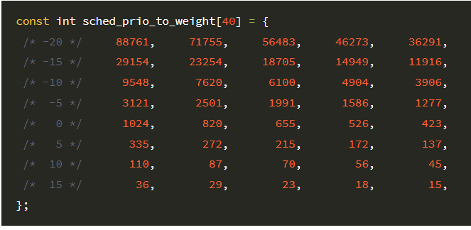
Before diving into scheduler
Process Priority
- nice value
-20 ~ +19 (default 0)
- ex) nice value a=0, b=5
a : weight = 1024*(1024+335) , b : weight = 335*(1024+335)

Slide 5
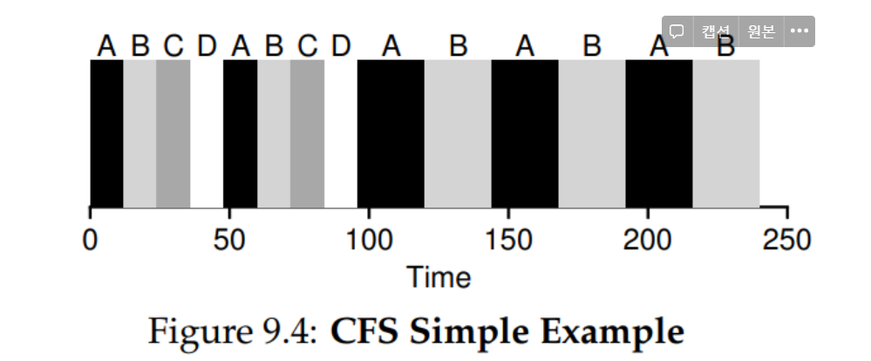
Concept of Linux program scheduler
Completely Fair Scheduler (CFS)
Assigns process a proportion of the processor not the timeslice
> fair (dividing sched latency – giving each timeslice)
> nice value decides the priority

Slide 6
Implementation of CFS scheduler
Time accounting
- account for the time that a process run (vruntime)
Process selection
- smallest vruntime in red black tree (__pick_next_entity())
- adding and removing form the tree
The scheduler entry point
- whether a reschedule should be performed (schedule())
Sleeping and waking up

Slide 7
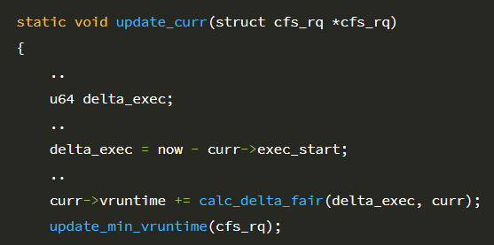
CFS – Time accounting
Time accounting
- update_curr()
- vruntime += delta_exec * NICE_0_LOAD / load weight

Slide 8


CFS – Time accounting
Time accounting
Scheduled based on virtual runtime (vruntime), not real runtime
In this way process A can be scheduled three times more than B

Slide 9
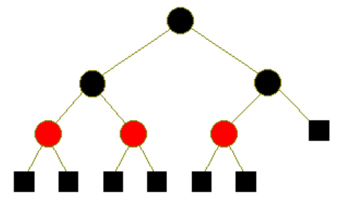
CFS – Process selection
Process selection
- Picking the process with the smaller virtual runtime
(among all runnable processes)
- left most child of rb tree
(_pick_next_entity())

Slide 10
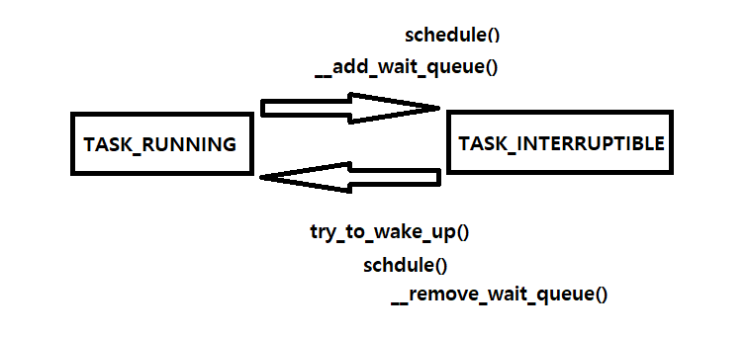
CFS – The scheduler entry point
The scheduler entry point & Sleeping and waking up
- need_resched flag (in thread_info structure)

Slide 11
Summary
Process scheduling
Process scheduling means deciding which process runs, when, and for how long
Can give illusion of multitasking with single processor
Completely fair scheduler (CFS)
Time accounting uses Virtual runtime
Process selection with Red black tree
Scheduler entry point with need_resched flag
Sleeping and waking up

Slide 12
Q & A
Reference
Linux kernel development (3rd edition by Robert Love) chapter 3,4
리눅스 커널 내부구조 chapter 3
Mad for Simplicity :: O(1) 스케줄러의 문제점과 CFS 스케줄러 (tistory.com)
Linux Kernel Scheduler [CFS] (notion.site)

